Slide 1

Calculating Emissions Within a Travel Demand Model Using MOVES Emissions Rates
Florida Department of Transportation Air Quality Postprocessor Framework
TRB Planning Applications Conference
Keli P. Kemp, AICP
May 9, 2011

Slide 2
Acknowledgements
Diana Fields & Vidya Mysore Florida Department of Transportation Systems Planning Office Tallahassee, FL
David Kall, Sheldon Harrison, Kazi Ullah Cambridge Systematics Atlanta, GA; Tallahassee, FL; & Cambridge, MA

Slide 3
Overview
Overview of Project
MOVES Inventory Mode v. Emissions Rate Mode
Interagency Coordination
FSUTMS Air Quality Postprocessor Framework
Emission Reduction Strategies
Lessons Learned
Implementation

Slide 4
Overview of Project
Need:
  EPA’s new 8-hour ozone standards
  Wide-spread impact on Florida
  Florida’s updated platform no longer included an emissions calculation process
  EPA’s release of MOVES
Purpose:
  Bridge the gap between the TDM and MOVES
  Automatically calculate emissions within TDM
  Use for conformity determinations by NAAs and scenario analysis

Slide 5

Overview of Project
Geography
FDOT District 3
Northwest Florida Regional Planning Model
Escambia, Santa Rosa, & Bay Counties

Slide 6
Overview of Project
What is MOVES?
Motor Vehicle Emissions Simulator (MOVES)
U.S. EPA’s model for estimating emissions from vehicles
Replaces previous model, MOBILE6.2
Required for State Implementation Plan (SIP) and transportation conformity emissions inventories

Slide 7
Overview of Project
What is the FSUTMS Air Quality Postprocessor?
A module within Florida Standard Urbanized Transportation Model Structure (FSUTMS)/Cube Voyager that calculates emissions
Calculates:
  Emissions related to Ozone formation
    Oxides of Nitrogen (NOx)
    Volatile Organic Compounds (VOCs)
  Emissions related to Greenhouse Gas (GHG) formation
    Carbon Dioxide Equivalents (CO2eq)
    Methane (CH4)
    Nitrous Oxide (N2O)
Users:
  Ozone NAAs for conformity
  Areas interested in measuring GHG emissions

Slide 8
Overview of Project
Schedule
Interagency Consultation
April 2009: EPA Released Draft MOVES2009
December 2009: EPA Released MOVES 2010
Began development of FSUTMS Air Quality Postprocessor (AQPP)
Incorporated non-running emissions and vehicle type implications
December 2010: Completed AQPP Framework
Documented emissions calculation process
July 2010: Conducted AQPP webinar for FDOT District 3
August 2010: EPA Released MOVES 2010a
Updated AQPP to reflect MOVES 2010a (new car and light truck energy and GHG rates)

Slide 9
MOVES Inventory v. Rate Mode
Two Options for Applying MOVES
Option 1: MOVES as an Emissions Inventory Model
  Requires running of MOVES every time the travel demand model is modified
  Uses output loaded network from travel demand model
Option 2: MOVES as an Emissions Rates Model
  Significantly reduces frequency of MOVES runs
  Uses emissions rates from MOVES as inputs into travel demand model
Travel Demand Model
MOVES
MOVES
Travel Demand Model

Slide 10
MOVES Inventory v. Rate Mode
Benefits of the FSUTMS AQPP
Streamlines Calculation of Emissions
  Minimizes number of times needed to run MOVES
  Shorter run times (TDM v. MOVES)
  Outputs summary tables in .csv and .dbf format
Standardized approach
  Reduces human error
  Facilitates transferability
  Streamlines interagency consultation process
Outputs link level running emissions that can be mapped

Slide 11
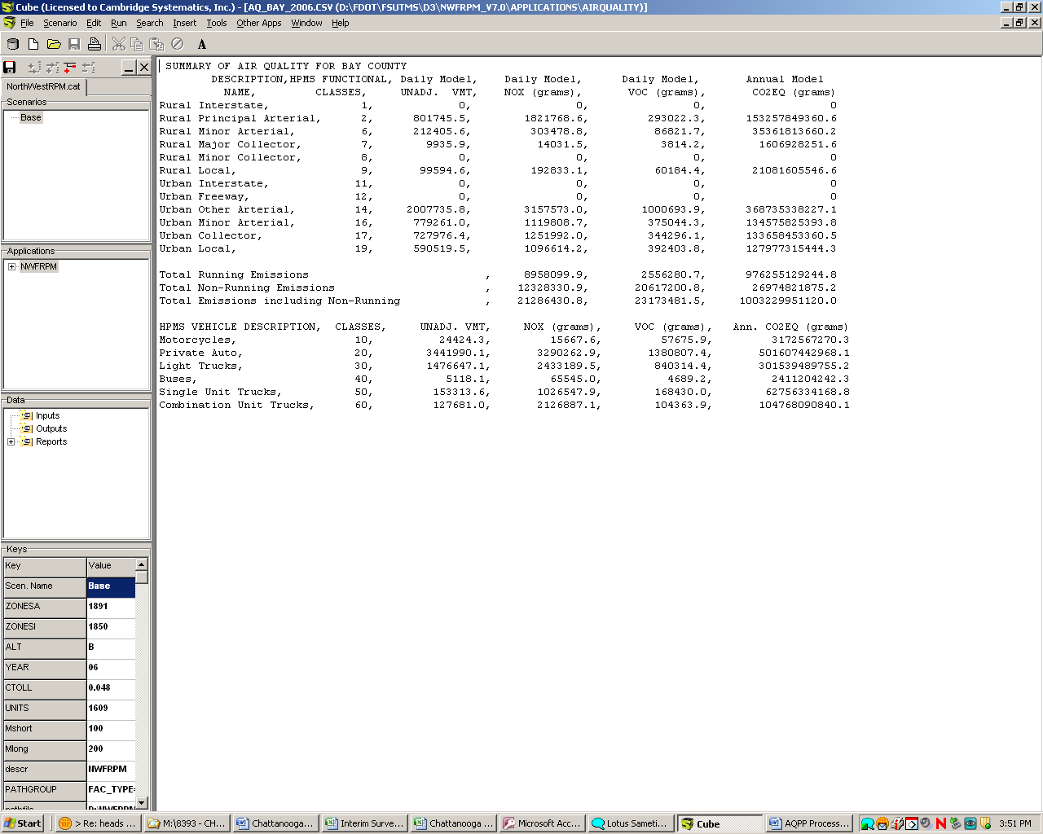
MOVES Inventory v. Rate Mode
FSUTMS AQPP Outputs

Slide 12
Interagency Coordination
Florida Department of Transportation
  Systems Planning Office Modeling Section
  Office of Policy Planning
  Public Transportation Office
  Transportation Statistics Office
  District 3
Florida Department of Environmental Protection
Federal Highway Administration, Florida Division
West Florida Regional Planning Council (staffs 3 MPOs)

Slide 13
Interagency Coordination
Data Requirements for County Data Manager
Source (Vehicle) Type Population
Inspection & Maintenance (I/M) Program
Fuel Supply
Meteorology
Vehicle Type Vehicle Miles Traveled (VMT)
Average Speed Distribution
Road Type Distribution
Age Distribution (Population based)
Ramp Fraction
Likely Use Local VMT Population with MOVES National Default Vehicle Type Ratios
AQPP
Framework Uses MOVES National Defaults
No National Defaults Available in MOVES (Must Use Travel Demand Model or HPMS Data)
National Defaults Available in MOVES (Obtain ICC Approval to Use National Defaults)

Slide 14
Interagency Coordination
Vehicle Type VMT
Passenger Trips
Motorcycles
Motorcycles
Passenger Cars
Passenger Cars
Light Trucks
Passenger Trucks
Light Commercial Trucks
Single Unit Trucks
Refuse Trucks
Single Unit Short-Haul Trucks
Single Unit Long-Haul Trucks
Motor Homes
Combination Trucks
Combination Short-Haul Trucks
Combination Long-Haul Trucks
School Buses
Transit Buses
Intercity Buses
Buses
Model
HPMS
MOVES

Slide 15
Emissions Modeling Process
Simplified Structure
Run MOVES
Reformat Emission Factors
Prepare Model Links
Calculate and Summarize Emissions
Notes:
At its core – AQPP consists of these basic modules…

Slide 16
Emissions Modeling Process
Step 1: Run MOVES in Emissions Rate Mode

Slide 17
Emissions Modeling Process
Step 2A: Reformat Emissions Factors

Slide 18
Emissions Modeling Process
Step 2B: Prepare Model Links

Slide 19
Emissions Modeling Process
Step 3: Calculate and Summarize Emissions

Slide 20
Emission Reduction Strategies
Strategies that can be tested within the AQPP¹
Highway Only Model
Bottleneck relief
Transit Included
Transit fare measures
Transit frequency/ LOS/Extent
Trucks Included
Truck only toll lanes
HOV lanes
Bike/Ped Included
Bike facilities
Urban transit expansion
Pedestrian facilities
Land use and smart growth strategies with pedestrian design characteristics
Toll lanes
Capacity expansion
Land Use & Smart Growth (large scale)
Pricing strategies²
¹ SHRP2 C09 Incorporating GHG Emissions into the Collaborative Decision-Making Process, PB Americas with Cambridge Systematics and E.H. Pechan & Associates, Inc. (work underway).
² Regional models generally require significant enhancement in order to fully capture the effects of pricing policies. Most models have some capabilities to model mode-shift, route-shift (e.g. from tolling specific roads), and destination choice (e.g., from CBD/activity center parking pricing) effects. However, they cannot model trips foregone (e.g., due to a VMT fee) or time-of-day shifts (e.g. due to congestion pricing).

Slide 21
Emission Reduction Strategies Ozone & GHG Reduction Strategies that can NOT be tested within the AQPP³
ITS/Systems Management
Carpool/vanpool/employer-based commute programs/incentives and other TDM strategies
Regulatory measures (urban parking restrictions and speed limit reductions)
Multimodal freight strategies (rail capacity, marine system improvements, shipping container permits, LCV permits, weight station bypass, truck idle reduction, freight villages)
³ SHRP2 C09 Incorporating GHG Emissions into the Collaborative Decision-Making Process, PB Americas with Cambridge Systematics and E.H. Pechan & Associates, Inc. (work underway).

Slide 22
Lessons Learned
Education is key
MOVES has new local data requirements that require more than just conversion of MOBILE6 inputs
Data coordination is imperative
Is your HPMS data reliable?
An in-depth knowledge of MOVES calculations processes is required to make your AQPP mirror MOVES inventory calculations

Slide 23
Implementation
Nonattainment Areas expected to develop their own local input data for MOVES (national defaults used in AQPP framework)
FDOT creating a generic AQPP for integration by the masses
  Expected to be completed by Fall 2011

Slide 24
Keli P. Kemp, AICP
Senior Associate
Cambridge Systematics
1566 Village Square Blvd., Ste. 2
Tallahassee, FL 32309
Email: kkemp@camsys.com
Phone: 850-219-6388
Contact Information
Diana Fields
Transportation Planner
Florida Department of Transportation
605 Suwannee St., MS 19
Tallahassee, FL 32399
Email: Diana.Fields@dot.state.fl.us
Phone: 850-414-4901

